Slide 1
Smart Netwuork Optimization: A Predictive AI Framework for Proactive Management
Leveraging Machine Learning to Forecast Network Congestion and Automate Bandwidth Reallocation
Presented By:
HackStreet Boys

Slide 2
Introduction
This presentation outlines the need for a proactive approach to network management through an AI-driven framework. We address the limitations of traditional reactive methods that often lead to performance degradation, and propose a comprehensive solution designed to forecast congestion and allocate bandwidth efficiently, ultimately enhancing operational productivity.

Slide 3
The Need for Proactive Network Management
Traditional network management is fundamentally reactive. We rely on alerts to tell us when a problem, like high latency or a full-blown outage, has already occurred. Our vision is a proactive, intelligent network that anticipates its own needs. By leveraging AI, we can forecast congestion events before they impact users and dynamically allocate resources to maintain seamless connectivity.

Slide 4
Our Solution: An End-to-End AI-Powered System
We have designed and implemented a complete, three-stage pipeline that transforms raw network logs into automated, intelligent recommendations. 1. Data Fusion Engine: This stage ingests, cleans, and merges data from seven disparate sources into a single, time-sorted, and model-ready dataset. It serves as the "single source of truth" for our network's state.

Slide 5
Our Solution: An End-to-End AI-Powered System
2. Predictive Core (AI Model): At the heart of our system is an XGBoost machine learning model. It analyzes a 12-hour historical window of network behavior to accurately forecast the probability of congestion for each router in the next hour.
3. Recommendation Engine: This final stage translates the AI's probabilistic forecast into concrete, actionable steps. It uses a sophisticated logic engine to recommend specific bandwidth increases, decreases, or monitoring actions.

Slide 6
The Data Fusion Engine
The accuracy of any AI model is dependent on the quality of its data. Our first critical step was to build a holistic dataset.
Data Sources Integrated : We successfully merged seven distinct datasets, including hourly router logs, daily application usage, user activity patterns, configuration change history, and external event logs.

Slide 7
The Dataset Generator Engine
We have noticed a couple of non-realistic and buggy data in the initial set. So we also decided to generate a dataset via script. The dataset generator have features like:
• Hourly Router Logs: Simulates realistic hourly logs for multiple routers, including traffic volume, latency, bandwidth allocation, and bandwidth usage. Traffic patterns change based on time of day (peak/evening/hours).
• Daily Application Summary: Aggregates simulated average and peak network traffic for different applications across each day.

Slide 8
The Dataset Generator Engine
• Daily User Summary: Tracks user activities per day, such as login counts and peak usage, then aggregates totals for all users.
• Configuration History: Generates records of when device-specific configuration changes occurred.
• External Events: Simulates the impact of external incidents (like outages or maintenance) that can alter traffic and latency patterns.

Slide 9
The Predictive Core
Our prediction strategy is built on three key pillars:
Advanced Algorithm : We selected XGBoost, a powerful and industry-proven gradient boosting algorithm known for its high performance on tabular data.
Contextual Feature Engineering : The model doesn't just see a single moment in time. By feeding it a 12-hour look-back window, we enable it to learn from trends, patterns, and the sequence of events leading up to congestion.

Slide 10
The Predictive Core
Specialized, Independent Models: Rather than one general model, we trained three distinct models, one for each router. This allows each model to become an expert on the unique traffic patterns and behaviors of its specific device.
This enabled the scalability of project, as adding or removing devices became O(1) !
(Key Result): This approach has yielded a 90% accuracy on generated input and 73% accuracy on given DataSet.

Slide 11
The Recommendation Engine
The final and most critical stage translates the AI's prediction into a concrete, intelligent action. Your bandwidth_recommendation code implements a sophisticated, multi-tiered logic.
Dual-Factor Analysis: The engine's decision is based on two key inputs:
The Predicted Future Risk: The congestion probability from the XGBoost model.
The Current Network State: The actual average bandwidth utilization and latency from the past 12 hours.

Slide 12
The Recommendation Engine
Tiered Decision Logic: The engine categorizes the risk and recommends actions accordingly:
Critical Risk (Prob >= 0.8): Aggressively increases bandwidth by 25-40% to prevent imminent congestion.
Moderate Risk (Prob >= 0.6): Proactively increases bandwidth by 15-20%, especially if current utilization or latency is also high.
Low Risk (Prob <= 0.2): Identifies opportunities for optimization. If utilization is very low, it recommends a slight bandwidth decrease to conserve resources.
Normal Operation: For all other cases, it recommends maintaining current levels or making small, preventive adjustments if utilization is high.
This nuanced approach ensures that the system is not only preventing problems but also optimizing for efficiency.

Slide 13
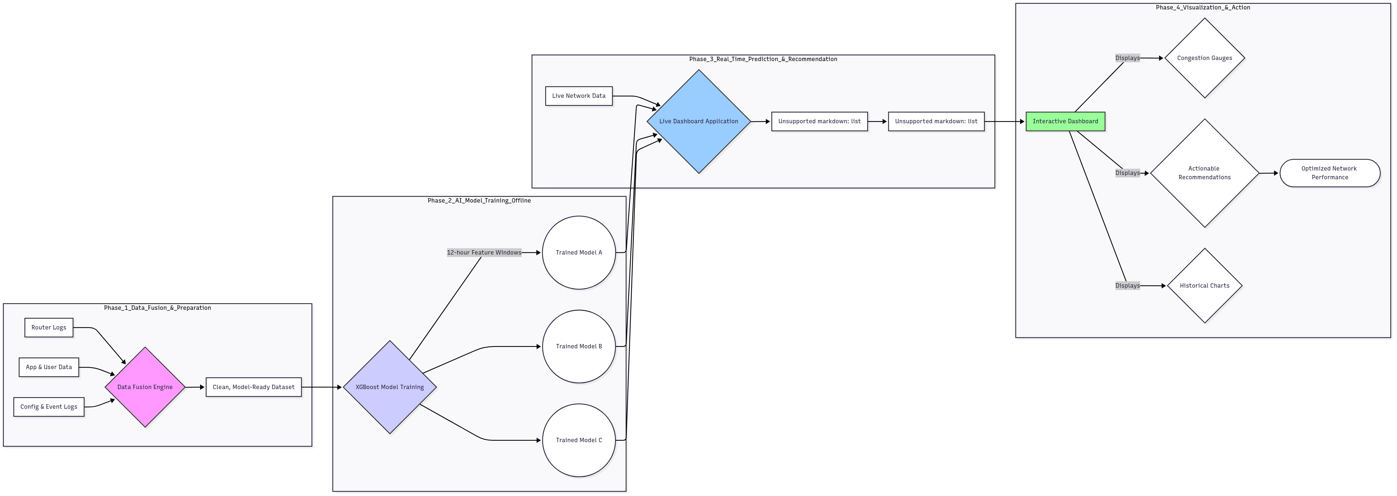
Flowchart

Slide 14
A Real-Time Dashboard
To make our system practical and usable, we developed an interactive dashboard using Streamlit. The dashboard serves as the primary interface for a network administrator, transforming the complex output of our AI model into a simple, intuitive, and actionable tool for real-time monitoring and decision support.
Dashboard Link : https://genesishackathon-hackstreetboys.streamlit.app
Load Pre-Trained Models: The dashboard starts by loading our three specialized, pre-trained XGBoost models from disk. This is efficient as no re-training is needed.
.

Slide 15
A Real-Time Dashboard
User Data Upload: The administrator uploads the latest network traffic data as a CSV file
Automated Prediction: The system automatically identifies the most recent 12-hour window in the data and feeds it to the models to predict congestion for the next hour.
Visualize & Recommend: The predictions are instantly passed to the recommendation engine, and the results—probabilities, actions, and historical graphs—are displayed on the screen.

Slide 16
A Real-Time Dashboard
(Key Features):
At-a-Glance Metrics: Color-coded probability gauges (🔴🟡🟢) provide an immediate sense of the congestion risk for each router.
Interactive Charts: Plotly graphs visualize the historical traffic and latency that informed the model's prediction, giving crucial context. In Development.
Detailed Recommendations: Each recommendation is presented in an expandable section, clearly stating the action, the amount of bandwidth change, and the reasoning behind it.
Prediction History: The dashboard keeps a running log of the most recent predictions, allowing for trend analysis and review.

Slide 17
Conclusion
We have successfully developed a concept for an AI-driven network optimization system. We have met all key project deliverables by creating a robust data pipeline, a high-accuracy predictive model, and an intelligent recommendation engine.

Slide 18
Future Roadmap
Phase 1 (Visualization): Develop a real-time dashboard to visualize network health, display current congestion probabilities, and log all automated actions taken by the system.
Phase 2 (Full Automation): Connect the recommendation engine to a Software-Defined Networking (SDN) controller. This will allow the system to execute bandwidth reallocations automatically, creating a truly self-optimizing network.
Phase 3 (Real-Time Integration): Deploy the model in a live environment, feeding it real-time network data streams instead of historical CSV files.

Slide 19

Thank you!
Do you have any questions?

